Slide 1
Chapter 11 Properties of Stock Options

Slide 2
Notation
c: | European call option price
p: | European put option price
S₀: | Stock price today
K: | Strike price
T: | Life of option
σ: | Volatility of stock price
C: | American call option price
P: | American put option price
S_{T}: | Stock price at option maturity
D: | PV of dividends paid during life of option
r | Risk-free rate for maturity T with cont. comp.

Slide 3
Effect of Variables on Option Pricing (Table 11.1)
Variable | c | p | C | P
S₀ | + | − | + | −
K | − | + | − | +
T | ? | ? | + | +
σ | + | + | + | +
r | + | − | + | −
D | − | + | − | +

Slide 4
American vs European Options
An American option is worth at least as much as the corresponding European option
C ≥ c
P ≥ p

Slide 5
Lower Bound for European Call Option Prices; No Dividends (Equation 11.4)
c ≥ max(S₀ –Ke ^{–rT}, 0)

Slide 6
Lower Bound for European Put Prices; No Dividends (Equation 11.5)
p ≥ max(Ke ^{-rT}–S₀, 0)

Slide 7
Put-Call Parity: No Dividends
Consider the following 2 portfolios:
Portfolio A: European call on a stock + zero-coupon bond that pays K at time T
Portfolio C: European put on the stock + the stock

Slide 8
Values of Portfolios (Table 11.2)
 |  | S_{T} > K | S_{T} < K
Portfolio A | Call option | S_{T} − K | 0
 | Zero-coupon bond | K | K
 | Total | S_{T} | K
Portfolio C | Put Option | 0 | K− S_{T}
 | Share | S_{T} | S_{T}
 | Total | S_{T} | K

Slide 9
The Put-Call Parity Result (Equation 11.6)
Both are worth max(S_{T} , K ) at the maturity of the options
They must therefore be worth the same today. This means that c + Ke ^{-rT} = p + S₀

Slide 10
Early Exercise
Usually there is some chance that an American option will be exercised early
An exception is an American call on a non-dividend paying stock
This should never be exercised early

Slide 11
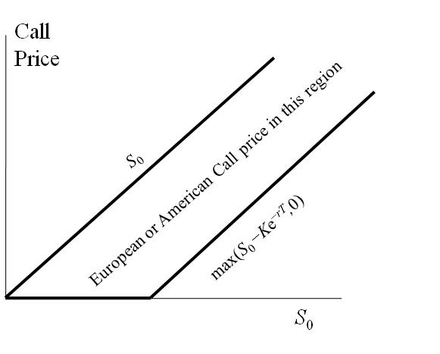
Bounds for European or American Call Options (No Dividends) Figure 11.3

Slide 12
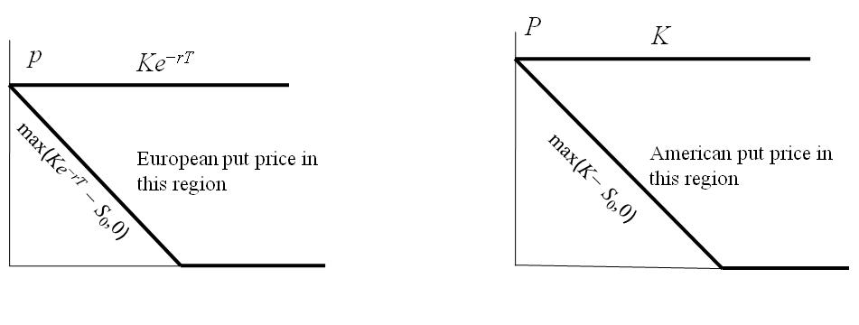
Bounds for European and American Put Options (No Dividends) Figure 11.4

Slide 13
The Impact of Dividends on Lower Bounds to Option Prices (Equations 11.8 and 11.9)

Slide 14
Extensions of Put-Call Parity
American options; D = 0
S₀ − K < C − P < S₀ − Ke^{−rT}
Equation 11.7
European options; D > 0
c + D + Ke ^{−rT} = p + S₀
Equation 11.10
American options; D > 0
S₀ − D − K < C − P < S₀ − Ke ^{−rT}
Equation 11.11

Slide 15
Chapter 12 Trading Strategies Involving Options

Slide 16
Strategies to be Considered
Bond plus option to create principal protected note
Stock plus option
Two or more options of the same type (a spread)
Two or more options of different types (a combination)

Slide 17
Principal Protected Note
Allows investor to take a risky position without risking any principal
Example: $1000 instrument consisting of
3-year zero-coupon bond with principal of $1000
3-year at-the-money call option on a stock portfolio currently worth $1000

Slide 18
Principal Protected Notes continued
Viability depends on
Level of dividends
Level of interest rates
Volatility of the portfolio
Variations on standard product
Out of the money strike price
Caps on investor return
Knock outs, averaging features, etc

Slide 19
Positions in an Option & the Underlying (Figure 12.1)
Profit
Profit
K
K
S_{T}
S_{T}
(a)
(b)
Profit
Profit
K
S_{T}
K
S_{T}
(c)
(d)

Slide 20
Bull Spread Using Calls (Figure 12.2)
Profit
S_{T}
K₁
K₂

Slide 21
Bull Spread Using Puts Figure 12.3
Profit
K₁
K₂
S_{T}

Slide 22
Bear Spread Using Puts Figure 12.4
Profit
K₁
K₂
S_{T}

Slide 23
Bear Spread Using Calls Figure 12.5
Profit
K₁
K₂
S_{T}

Slide 24
Box Spread
A combination of a bull call spread and a bear put spread
If all options are European a box spread is worth the present value of the difference between the strike prices
If they are American this is not necessarily so (see Business Snapshot 11.1)

Slide 25
A Straddle Combination Figure 12.10
Profit
K
S_{T}

Slide 26
Butterfly Spread Using Calls Figure 12.6
Profit
K₁
K₂
K₃
S_{T}

Slide 27
Butterfly Spread Using Puts Figure 12.7
Profit
K₁
K₂
K₃
S_{T}

